Slide 1



Session 1
CADM – Open source

Slide 2

MEET THE TRAINERS
Zubair Saif
Senior Consultant – Systems Limited
CADM

Slide 3

Key Learning Outcome
Getting Started with Angular, Prerequisite
Application Architecture and Folder Structure
Modules, Components, Directives
Decorators, Life Cycle Hooks, Services
HTTP, Routing and Dependency Injection
Forms and Validations, Pipes, Guards
Observables, RxJs, Comparing Promises
Styling, Event and Property Binding

Slide 4
Prerequisite
HTML and CSS
Prior TypeScript knowledge is required
Basic JavaScript knowledge is required

Slide 5

Agenda
Introduction to Angular
Angular Versions and Evolution
Setting Up Environment
Getting Started with Angular
Decorator
Module, Components and Directives

Slide 6

Introduction to Angular

Slide 7
Introduction
What is Angular?
Angular is a development platform for building modern web and mobile applications.
It uses typescript and HTML as its main languages for building user interfaces.
Angular provides features like components, directives, forms, and HTTP services to create interactive and dynamic applications.
With its modular architecture and powerful tools, angular simplifies the process of building complex and feature-rich single-page applications.

Slide 8
Introduction
Features and Benefits
Component-based
Powerful templates
Dependency injection
Rxjs observables
CLI tools
Cross-platform
Community

Slide 9
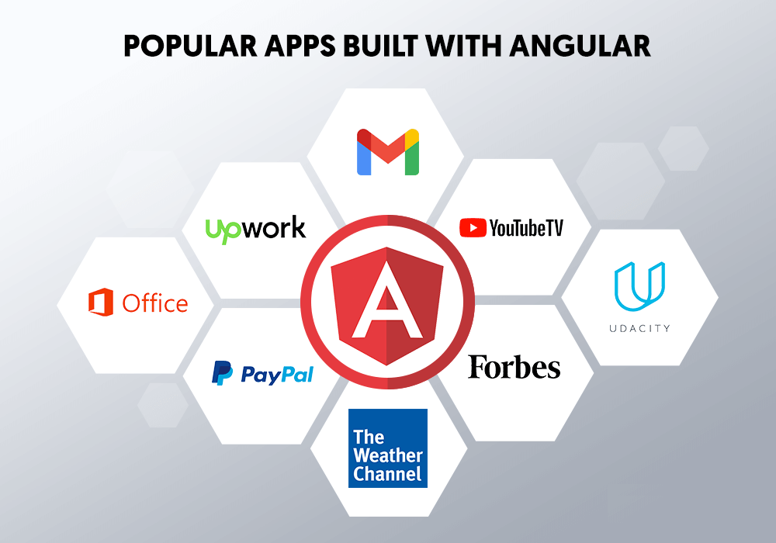
Popular apps build with Angular

Slide 10



Angular Vs Angular.Js
Angular
Angular js

Slide 11
Angular Vs Angular.Js
• Angular js is Oldest Version not in use now
• Latest Version after version 2
• Angular is a Re-written version, Structure and upgraded framework

Slide 12
Angular Versions and Evolution

Slide 13
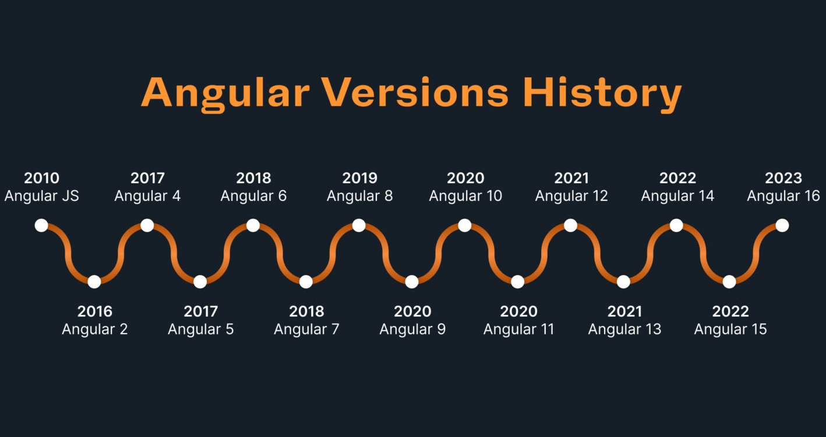

Slide 14
Setting up environment

Slide 15
Setting up environment
Setting up node and npm
To start your angular projects, you need node.Js and npm.
Here's how to set them up:
Node.Js installation: get node.Js from (https://nodejs.Org/), which includes npm for managing packages.
Download & install: run the installer and follow instructions.
Verify installation: open terminal and check node.Js and npm versions with node -v and npm -v.
Npm benefits: npm helps install and manage tools for your angular projects.

Slide 16
Setting up environment
Installing Angular CLI
To install the angular CLI follow these steps:
Open terminal
Install angular CLI: npm install -g @angular/cli
Verify installation: ng version

Slide 17
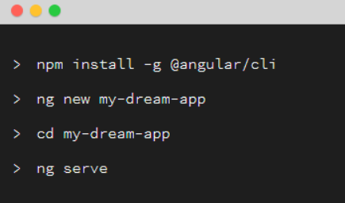
Installing Angular CLI
> node -v
> npm -v
> npm install -g @angular/cli
> ng version

Slide 18
Getting started with Angular

Slide 19
Getting started with Angular
Creating a new Angular project
To create a new angular project, you can use the angular cli
Here's how you can create a new angular project:
Open terminal
Create new project: ng new my-angular-app
Navigate to project: cd my-angular-app
Server application: start the development server to preview your app: ng server
Access your app: open your browser and go to http://localhost:4200 to see your Angular app.

Slide 20
Creating a new Angular project
> ng new my-angular-app
> cd my-angular-app
> ng server

Slide 21
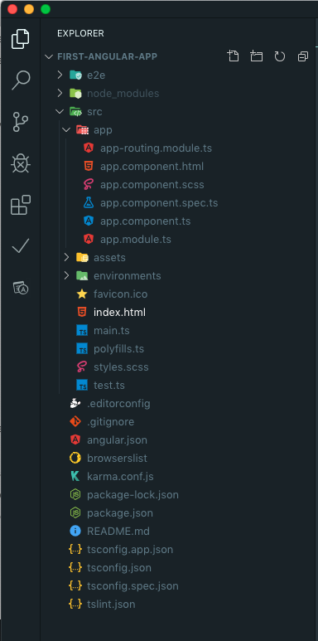
Project Structure

Slide 22
Running and building Angular apps
When your app is ready, build it for production using the following command:
> ng build --prod
The optimized build will be available in the dist directory. You can deploy this to a web server.

Slide 23
Decorator in Angular

Slide 24
Decorator in Angular
Decorator
In Angular, a decorator is a special kind of declaration that can be attached to classes, methods, properties, or parameters. It's used to enhance or modify the behavior of the target it's attached to.
Usage: Decorators are used by prefixing them with an "@" symbol and placing them just above the target declaration
Metadata: Decorators can accept parameters, often in the form of metadata, which provide additional information about the target.
For example, the @Component decorator is used to define components, the @NgModule decorator is used to define modules, and the @Directive decorator is used to define custom directives.

Slide 25
Module, Components and Directives

Slide 26
Introduction to Module
Module in Angular
A module is a logical container that groups related components, directives, pipes, and services together. Modules help you manage the organization of your application by providing a way to encapsulate functionality into distinct areas. Each Angular application has at least one root module, conventionally named AppModule.
The root module is usually named AppModule, and it's created when you generate a new Angular project.
You can create additional feature modules to organize different parts of your application.
Modules are defined using the @NgModule decorator.

Slide 27
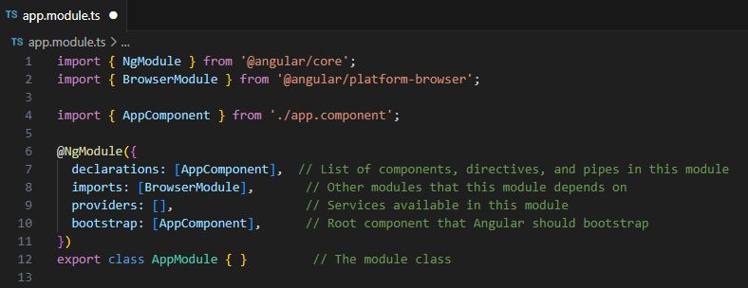
Module in Angular
The @NgModule decorator is used to define a module.
The `declarations` array lists the components, directives, and pipes that are part of this module.
The `imports` array includes other modules that this module depends on. In this case, we're importing `BrowserModule`, which provides essential features for running the app in a web browser.
The `providers` array is used to register services that are available within this module.
The `bootstrap` array specifies the root component that angular should use to bootstrap the application.
The module class `AppModule` is defined and exported.

Slide 28
Components and Directives
Understanding Components
Components and directives are fundamental building blocks in angular that enable you to create dynamic and reusable user interfaces.
Components
Components are the basic building blocks of an angular application. They encapsulate the logic and view of a part of the user interface.
Generate component: ng generate component component-name
Key concepts:
Class: defines the component's behavior, properties, and methods.
Template: defines the component's UI structure using HTML. Interpolation (`{{ }}`) and property binding (`[ ]`) allow you to display dynamic data.
Metadata: provides additional information about the component using decorators, such as @component.

Slide 29
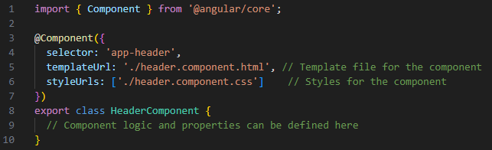
Using Components
selector: to use component in template, use it selector as an HTML tag.
For example, if the component selector is `app-header`, use <app-header> </app-header>.
templateUrl or template: it specifies the external HTML file or inline template for the component's view.
styleUrls or styles: it points to external CSS files or inline styles for styling the component's view.
encapsulation: it defines how the component's styles are scoped and applied. Angular provides three options: Emulated (default), None, and ShadowDom.

Slide 30
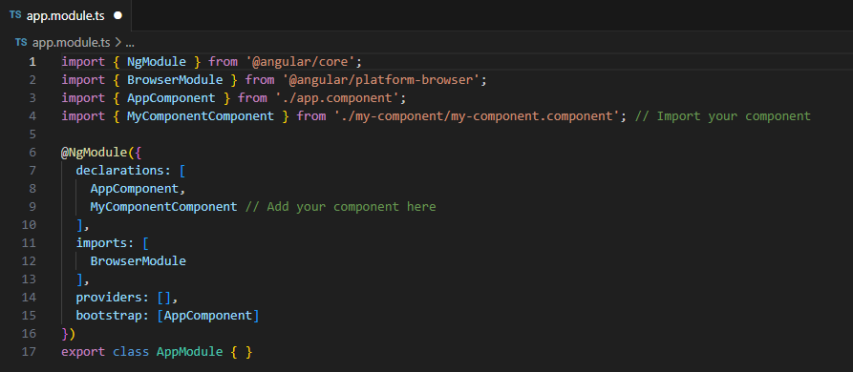
Add to Module
Angular components must be declared in a module. Open the module file (e.g., app.module.ts) and add your component to the declarations array:
30

Slide 31
Using Components
In Angular, there are four types of bindings that facilitate the communication between the components.
Interpolation: It uses double curly braces {{ }} to bind the component's property values to the template. It's a form of one-way data binding where values are inserted into the template.
Property binding: It allows you to bind the value of a component's property to an HTML element's property. This is also a form of one-way data binding.
Event binding: It allows you to listen to events raised in the template (such as button clicks) and trigger methods in the component's typescript code.
Two-way binding: this is a combination of property binding and event binding. It allows you to both update the view when the model changes and update the model when the view changes. It's achieved using the [(ngmodel)] syntax.

Slide 32
Introduction to Directives
Directives in Angular
Directives in Angular allow you to extend the behavior of elements in the DOM. There are three types of directives in angular:
Component directives: These are the most common directives and they represent components, which are the basic building blocks of an angular application.
Attribute directives: These modify the appearance or behavior of an existing element. They change the behavior or appearance of an element, component, or another directive.
Structural directives: These change the DOM layout by adding, removing, or manipulating elements. They shape or reshape the structure of the view.
Directives are a powerful way to create reusable pieces of functionality that can be applied to various parts of your angular application.

Slide 33
Directives and Data Binding
Directives modify DOM elements, enabling functionalities like conditional rendering and styling. Data binding synchronizes component logic with the user interface for responsive user experiences.
Directives Enhance Binding: Directives such as ngFor, ngIf, ngClass, and ngStyle contribute significantly to binding functionality.
Dynamic DOM Manipulation: These directives enable dynamic manipulation of the DOM by allowing conditional rendering and styling based on component properties.
Iterative Rendering: ngFor is used for iterating over data collections and dynamically rendering elements based on the provided data.
Conditional Display: ngIf directive controls the visibility of elements in the template based on specified conditions.
Dynamic Styling: ngClass and ngStyle directives allow applying CSS classes and inline styles dynamically, driven by component properties.

Slide 34

Assignment - 1
Objective: Combine your knowledge of components and directives to create a simple web application.
Design a web application that consists of multiple components, including header, content, and footer sections.
Utilize directives to enhance the application's functionality, such as displaying a list of items using "ngFor" and toggling content using "ngIf"
Implement styles to enhance the visual appearance of your application.
Serve the application locally using the Angular CLI and ensure its proper functioning.
IMPORTANT: Please use a GitHub repository for your assignment submission. Kindly send the repository link along with your employee ID in the email body. Subject of email should be exactly "Angular Assignment 1" nothing more, not even difference in case or space.
Deadline: Start of session 2
EMAIL: mzubair.saif@systemsltd.com atif.riaz@systemsltd.com

Slide 35
Assignment instructions
Component Creation: Create a new Angular project using the Angular CLI. Generate at least three components: "HeaderComponent," "ContentComponent," and "FooterComponent."
Component Communication: Implement communication between the components. Pass data from the "HeaderComponent" to the "ContentComponent" and use it to display relevant information.
Directive Utilization: Inside the "ContentComponent," use the "ngFor" directive to iterate over an array of items and display them dynamically. Apply the "ngIf" directive to conditionally display a section based on a specific condition.
Styling with Directives: Enhance the user experience by applying the "ngStyle" directive to dynamically style an element within the "FooterComponent."

Slide 36

ANY QUESTION?

Slide 37



THANK YOU
Zubair Saif
mzubair.saif@systemsltd.com
Atif Riaz
atif.riaz@systemsltd.com
CADM – OPEN SOURCE

